Slide 1
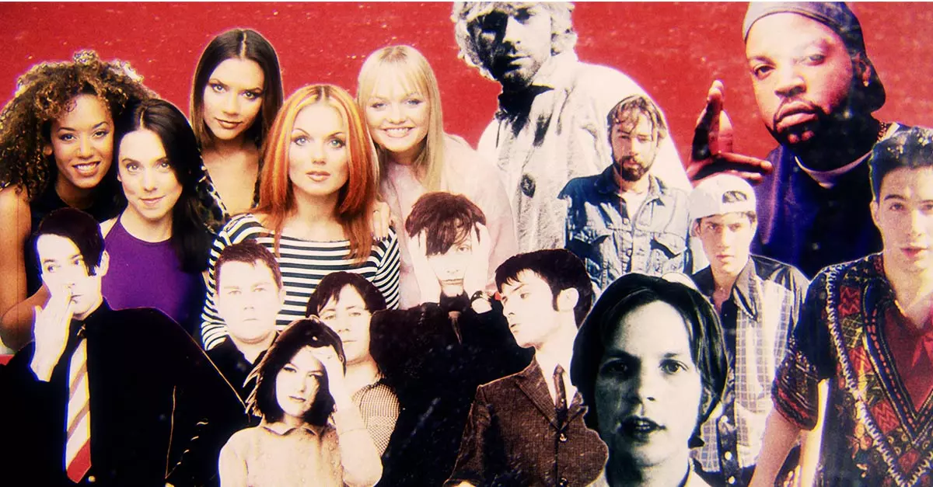
1990s
Artist / Band | Week Beginning
Ace of Base | 02.11.26.
Gabrielle | 09.11.26.
5ive | 16.11.26.
Bryan Adams | 23.11.26.
Des’ree | 30.11.26.
Jamiroquai | 07.12.26.
S Club | 14.12.26.
Term 1.2.

Slide 2
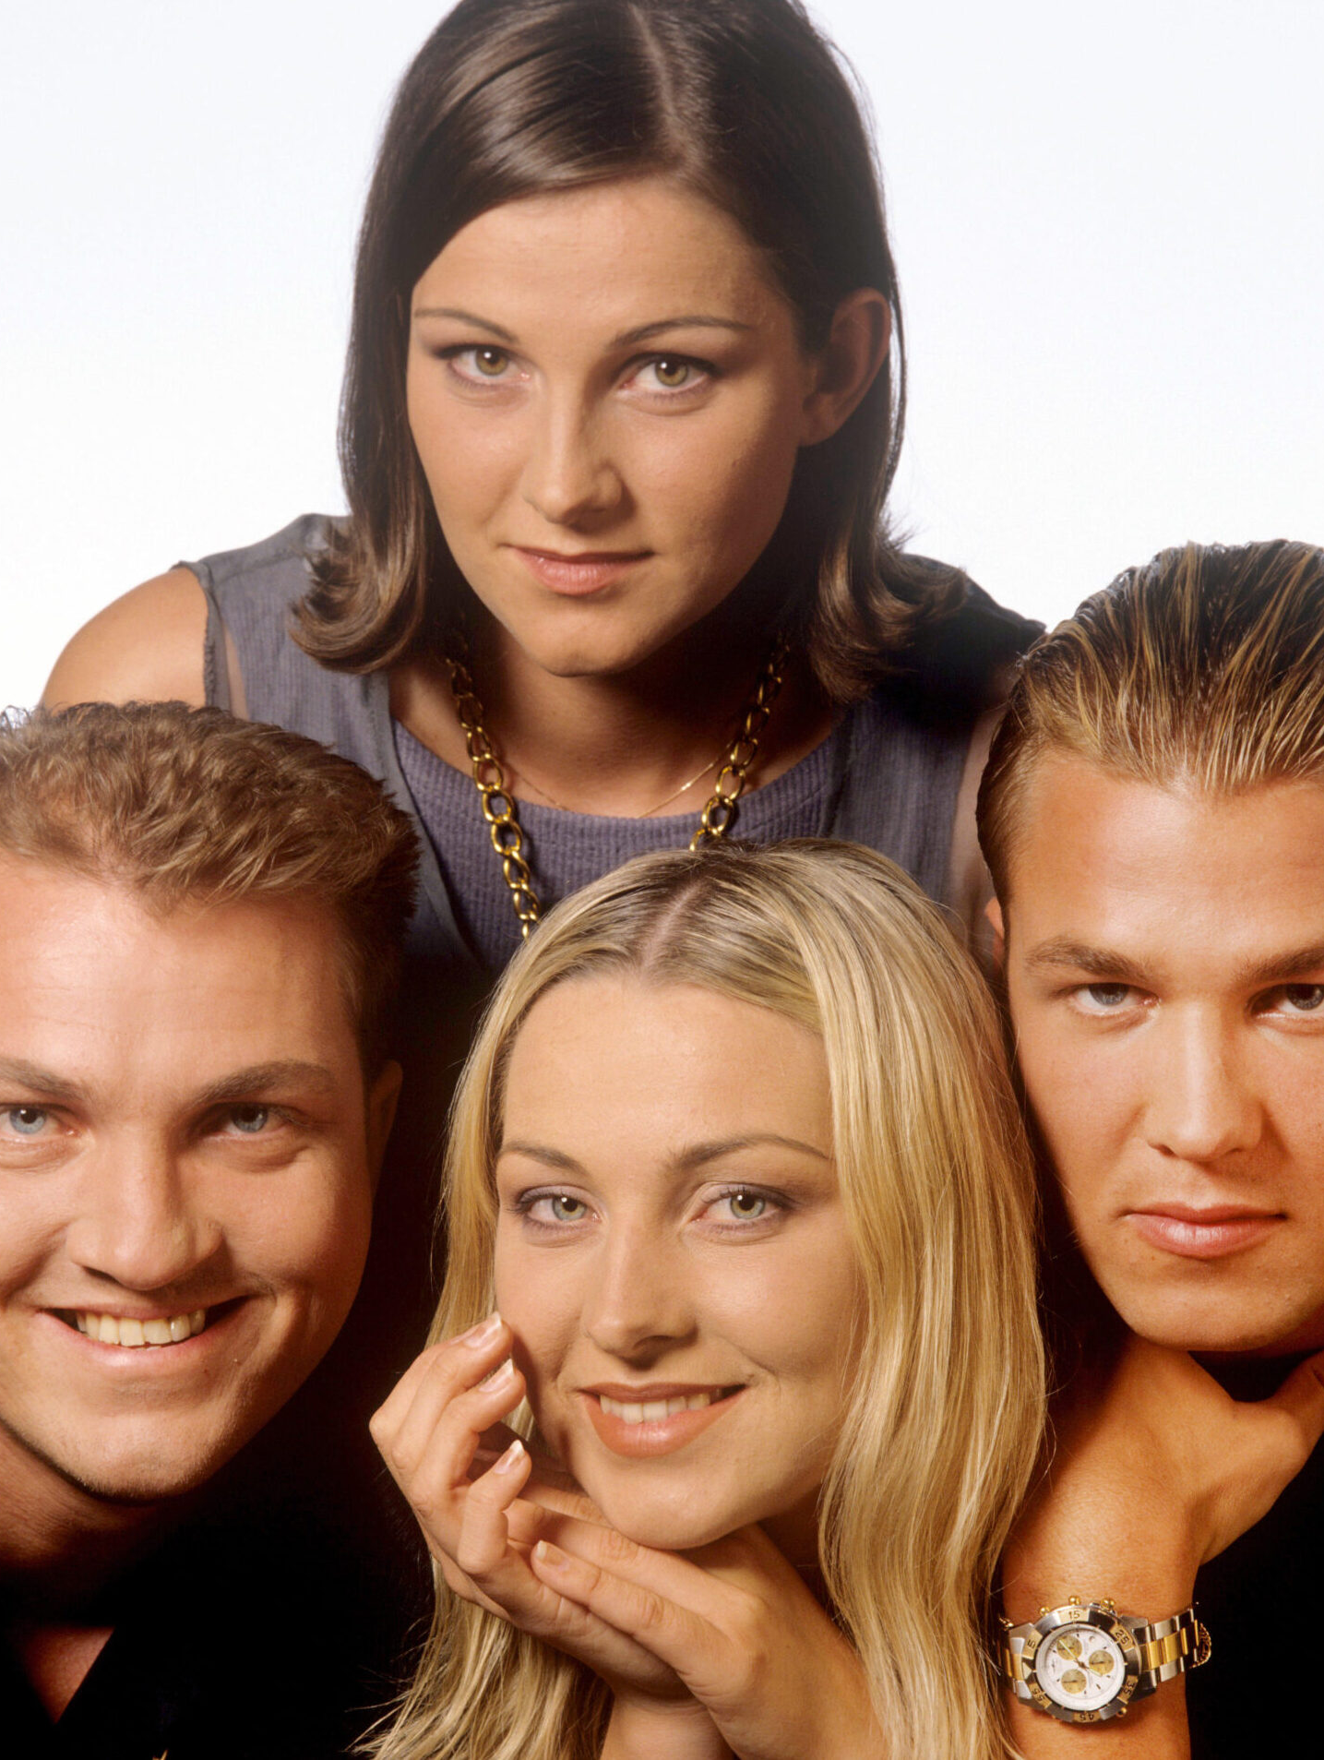
Ace of Base
Ace of Base is a pop music group from Gothenburg, Sweden. The band started in 1987 and was made up of siblings Jonas, Linn, and Jenny Berggren, along with their friend Ulf Ekberg.
Their first album, Happy Nation (later called The Sign), became a huge success around the world. It was one of the best-selling debut albums ever and included hit songs such as "All That She Wants" and "The Sign".
Ace of Base is one of Sweden's most successful music groups. They sold 30 million copies of their first four albums, making them one of the country's biggest bands after ABBA and Roxette.
The band performed at major international events. In 1995, they performed the song "Lucky Love" at the World Championships in Athletics in Gothenburg, Sweden, and later appeared at major music award shows around the world.

Slide 3
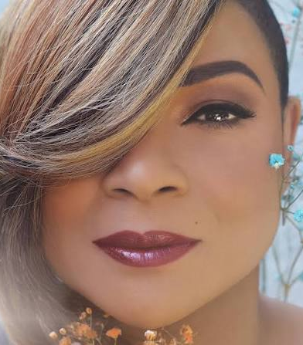
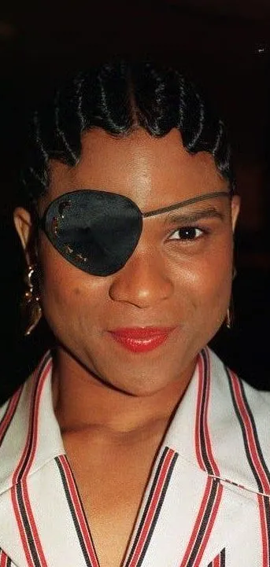
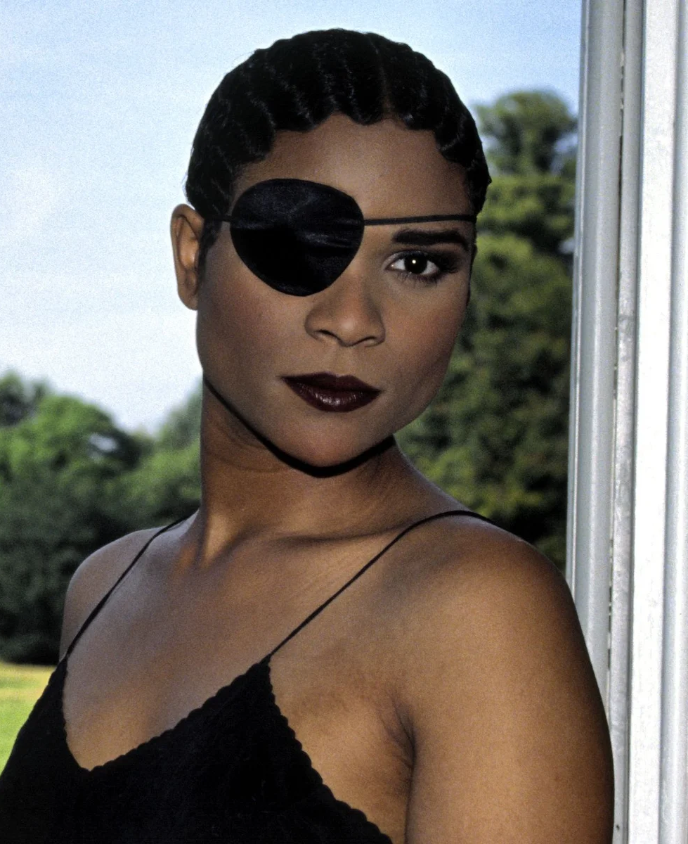
Gabrielle
Gabrielle's full name is Louise Gabrielle Bobb. She is a British singer known for her soulful R&B music.
She became very popular in the 1990s. Her music was enjoyed by millions of people around the world.
Her hit song "Dreams" was a huge success. It reached the top of the music charts and helped make her famous.
Gabrielle is known for her distinctive voice and her eye patch. She has released many successful albums and continues to be loved by fans.

Slide 4
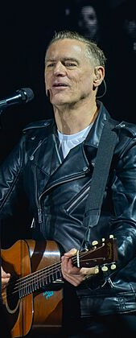
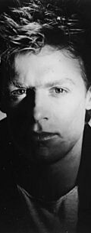
Bryan Adams
Bryan Adams is a famous Canadian singer, songwriter, and musician. He was born in Kingston, Ontario, Canada, on 5 November 1959.
He became a worldwide star with his album Reckless (1984). The album included popular songs such as "Summer of '69", "Run to You", and "Heaven".
His song "(Everything I Do) I Do It for You" was a huge international hit. Released in 1991, it reached number one in at least 19 countries.
Bryan Adams has performed at major sporting events. He sang at the opening ceremony of the 2010 Winter Olympics in Vancouver, Canada, and has also performed at many large charity concerts around the world.

Slide 5
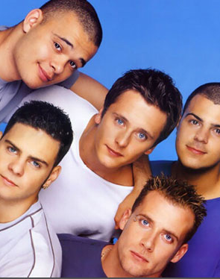
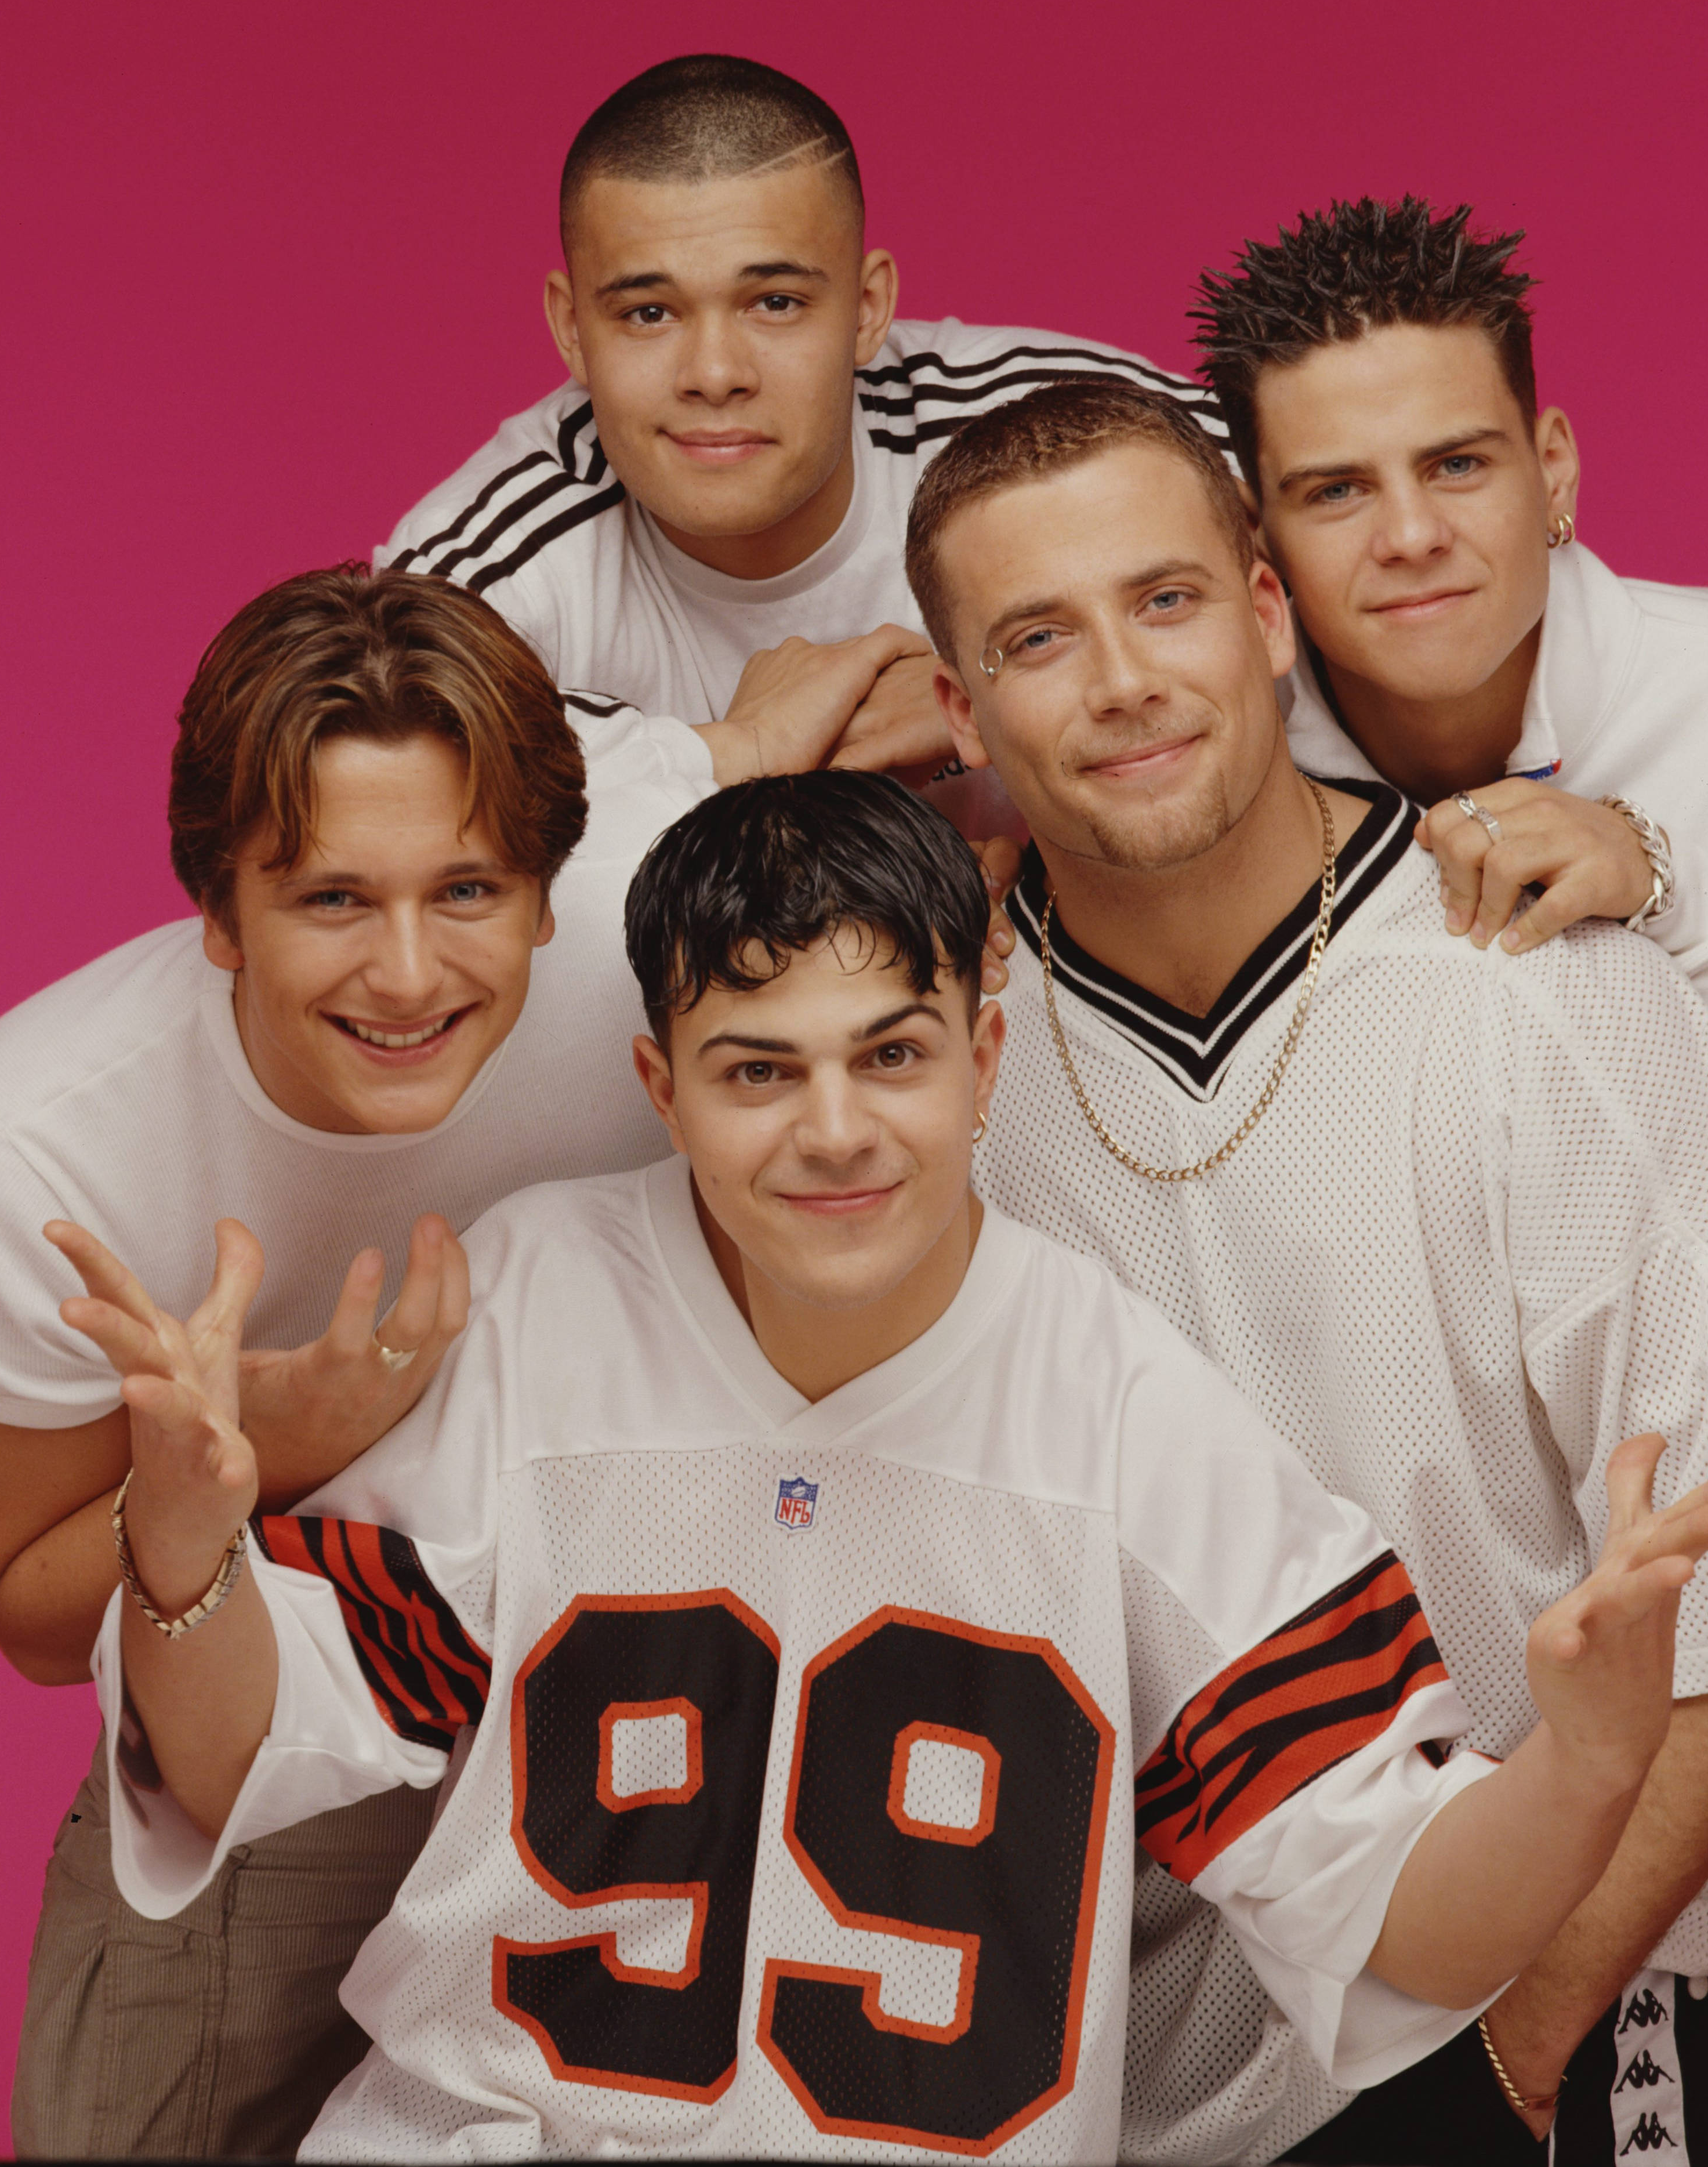
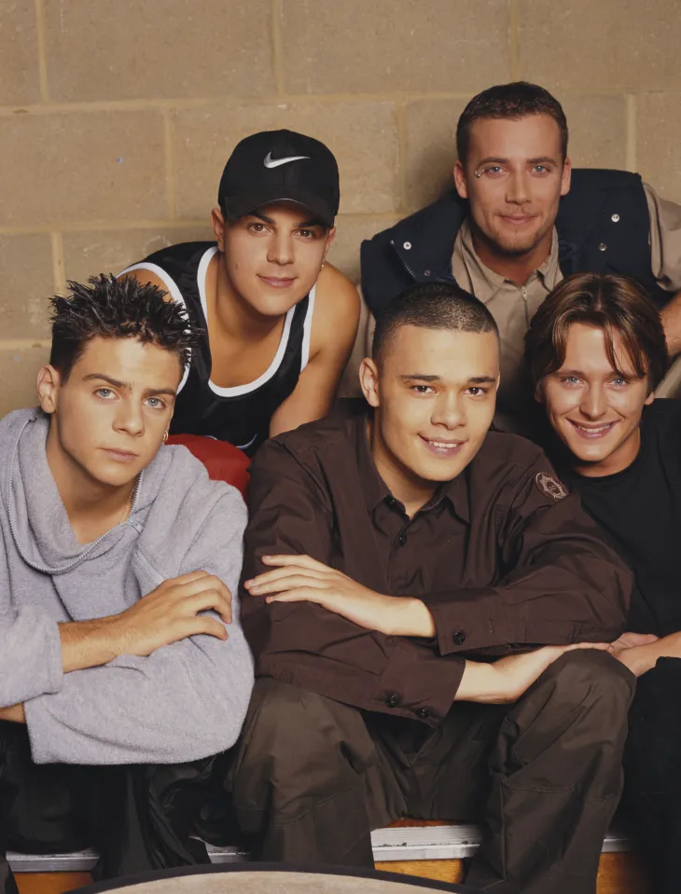
5ive
5ive is an English boy band that was formed in London in 1997. They were created by the same team that helped form the Spice Girls.
The band became popular around the world. They had fans in the UK, Europe, Australia, New Zealand, the USA, and many other countries.
5ive sold almost 20 million records and had 11 top-ten singles in the UK. This made them one of the most successful British boy bands of their time.
The group's five original members were Scott Robinson, Ritchie Neville, Jason "J" Brown, Abz Love, and Sean Conlon. Although they split up in 2001, they later got back together and reformed in 2012.

Slide 6

Des’ree
Des'ree is an English singer and songwriter. Her full name is Desirée Annette Weekes, and she was born in Croydon, London, in 1968.
She became famous in the 1990s for her pop and soul music. Some of her best-known songs include "You Gotta Be", "Life", and "Feel So High".
Des'ree performed at a major sporting event. She sang "You Gotta Be" at the closing ceremony of the 1996 Summer Olympics, watched by millions of people around the world.
She won the BRIT Award for Best British Female Solo Artist in 1999. She has also received other important music awards for her songs and performances.

Slide 7
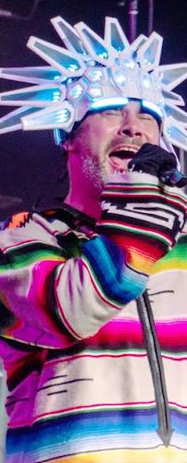
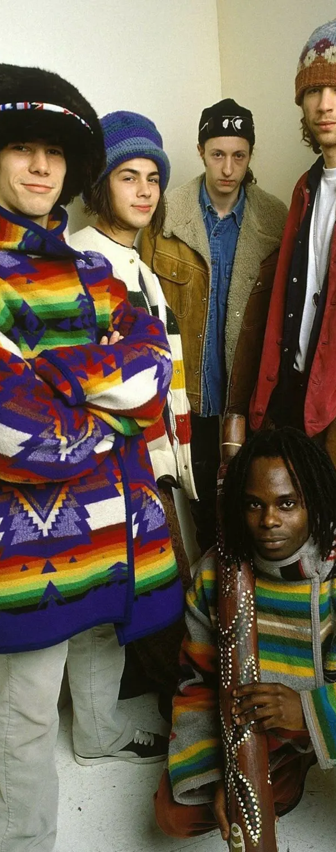
Jamiroquai
Jamiroquai is a British band from London that started in 1992. The band is famous for mixing funk and acid jazz music.
The band's lead singer is Jason Kay, also known as Jay Kay. He started the band and has remained its lead singer throughout its history.
The name "Jamiroquai" combines the words "jam" and "Iroquois". A jam session is when musicians play music together freely, and the Iroquois are a Native American people.
Their song "Virtual Insanity" became a worldwide hit in 1996. Its creative music video won four MTV Video Music Awards and helped make the band famous around the world.

Slide 8
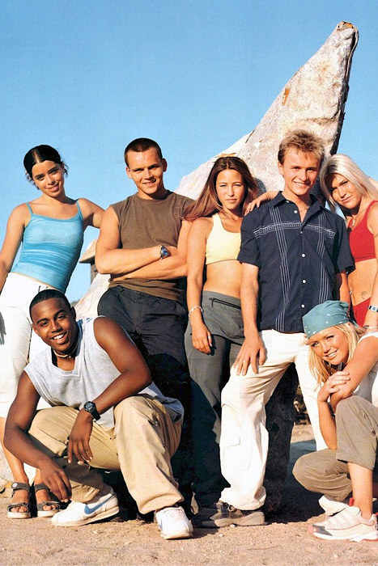
S Club
S Club is a British pop group that was formed in London in 1998. The group was originally called S Club 7 because it had seven members.
They became famous for their catchy songs and fun music videos. S Club was one of the most popular pop groups of the late 1990s and early 2000s.
The group released several successful albums, including S Club (1999), 7 (2000), and Sunshine (2001).
Although the group split up in 2003, some members reunited later and continued performing as S Club.

