Slide 1
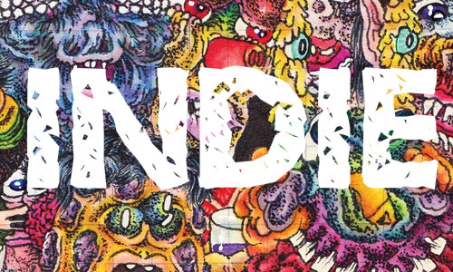
Indie
Artist / Band | Week Beginning
Gorillaz | 01.09.26.
The Kooks | 07.09.26.
Florence & the Machine | 14.09.26.
Mumford & Sons | 21.09.26.
Blur | 28.09.26.
Oasis | 05.10.26.
Kaiser Chiefs | 12.10.26.
Artic Monkeys | 19.10.26.
Term 1.1.

Slide 2
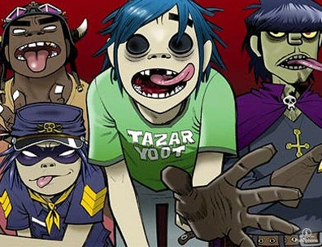
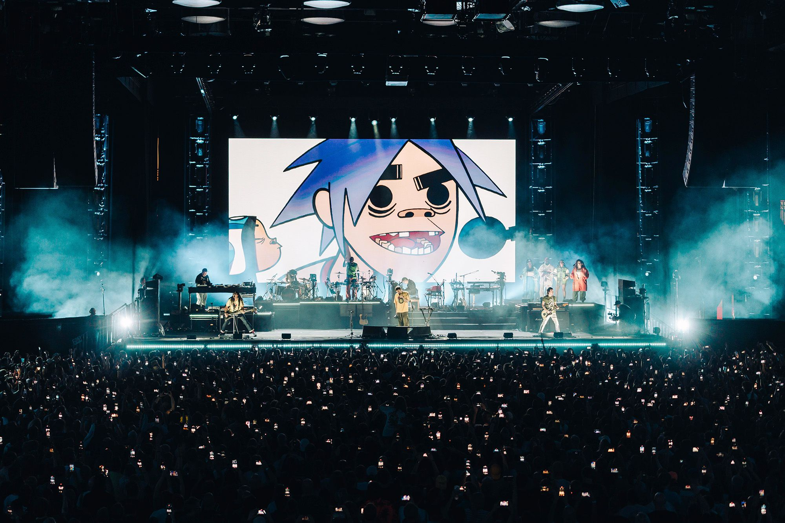
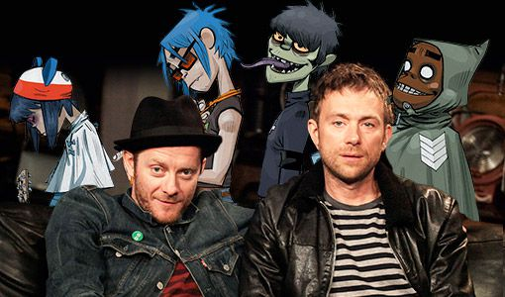
Gorillaz
Gorillaz is a super cool English virtual band created in 1998 by musician Damon Albarn and artist Jamie Hewlett.
What makes them special is that the main band members are four animated characters!
You can find the Gorillaz characters in their awesome music videos, fun interviews, comic strips, and short cartoons.
Damon Albarn is the only real-life musician who is always part of the music. He loves to work with many different artists and musicians on their songs.
With Gorillaz, Damon Albarn explored many musical styles like hip hop, electronic, and world music.

Slide 3
Gorillaz
Gorillaz is a super cool English virtual band created in 1998 by musician Damon Albarn and artist Jamie Hewlett.
What makes them special is that the main band members are four animated characters!
You can find the Gorillaz characters in their awesome music videos, fun interviews, comic strips, and short cartoons.
Damon Albarn is the only real-life musician who is always part of the music. He loves to work with many different artists and musicians on their songs.
With Gorillaz, Damon Albarn explored many musical styles like hip hop, electronic, and world music.

Slide 4
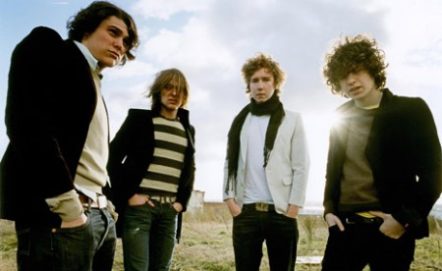
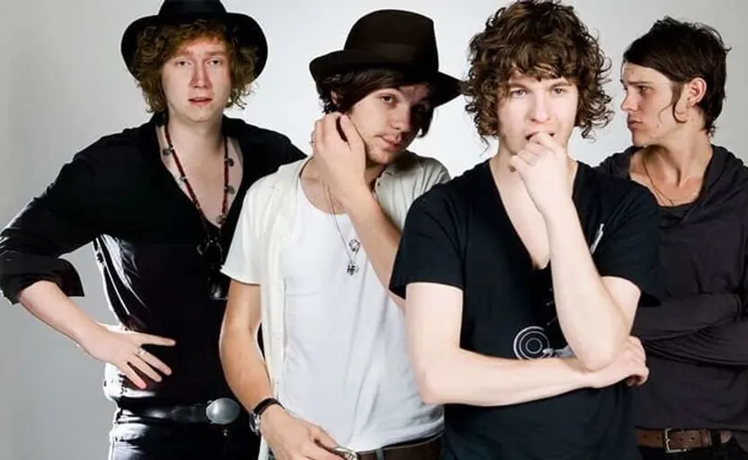
The Kooks
The Kooks are a British indie rock band from Brighton, England. They were founded by Luke Pritchard, Hugh Harris, and Paul Garred and became successful around the world.
The band has been making music since 2004. Their catchy songs helped them become one of the leading bands in the British indie music scene.
Their first album, Inside In/Inside Out (2006), was very popular. It sold so well in the UK that it was certified four-times Platinum.
The band's name came from a David Bowie song. The members chose the name after hearing the song "Kooks" on Bowie’s album Hunky Dory

Slide 5
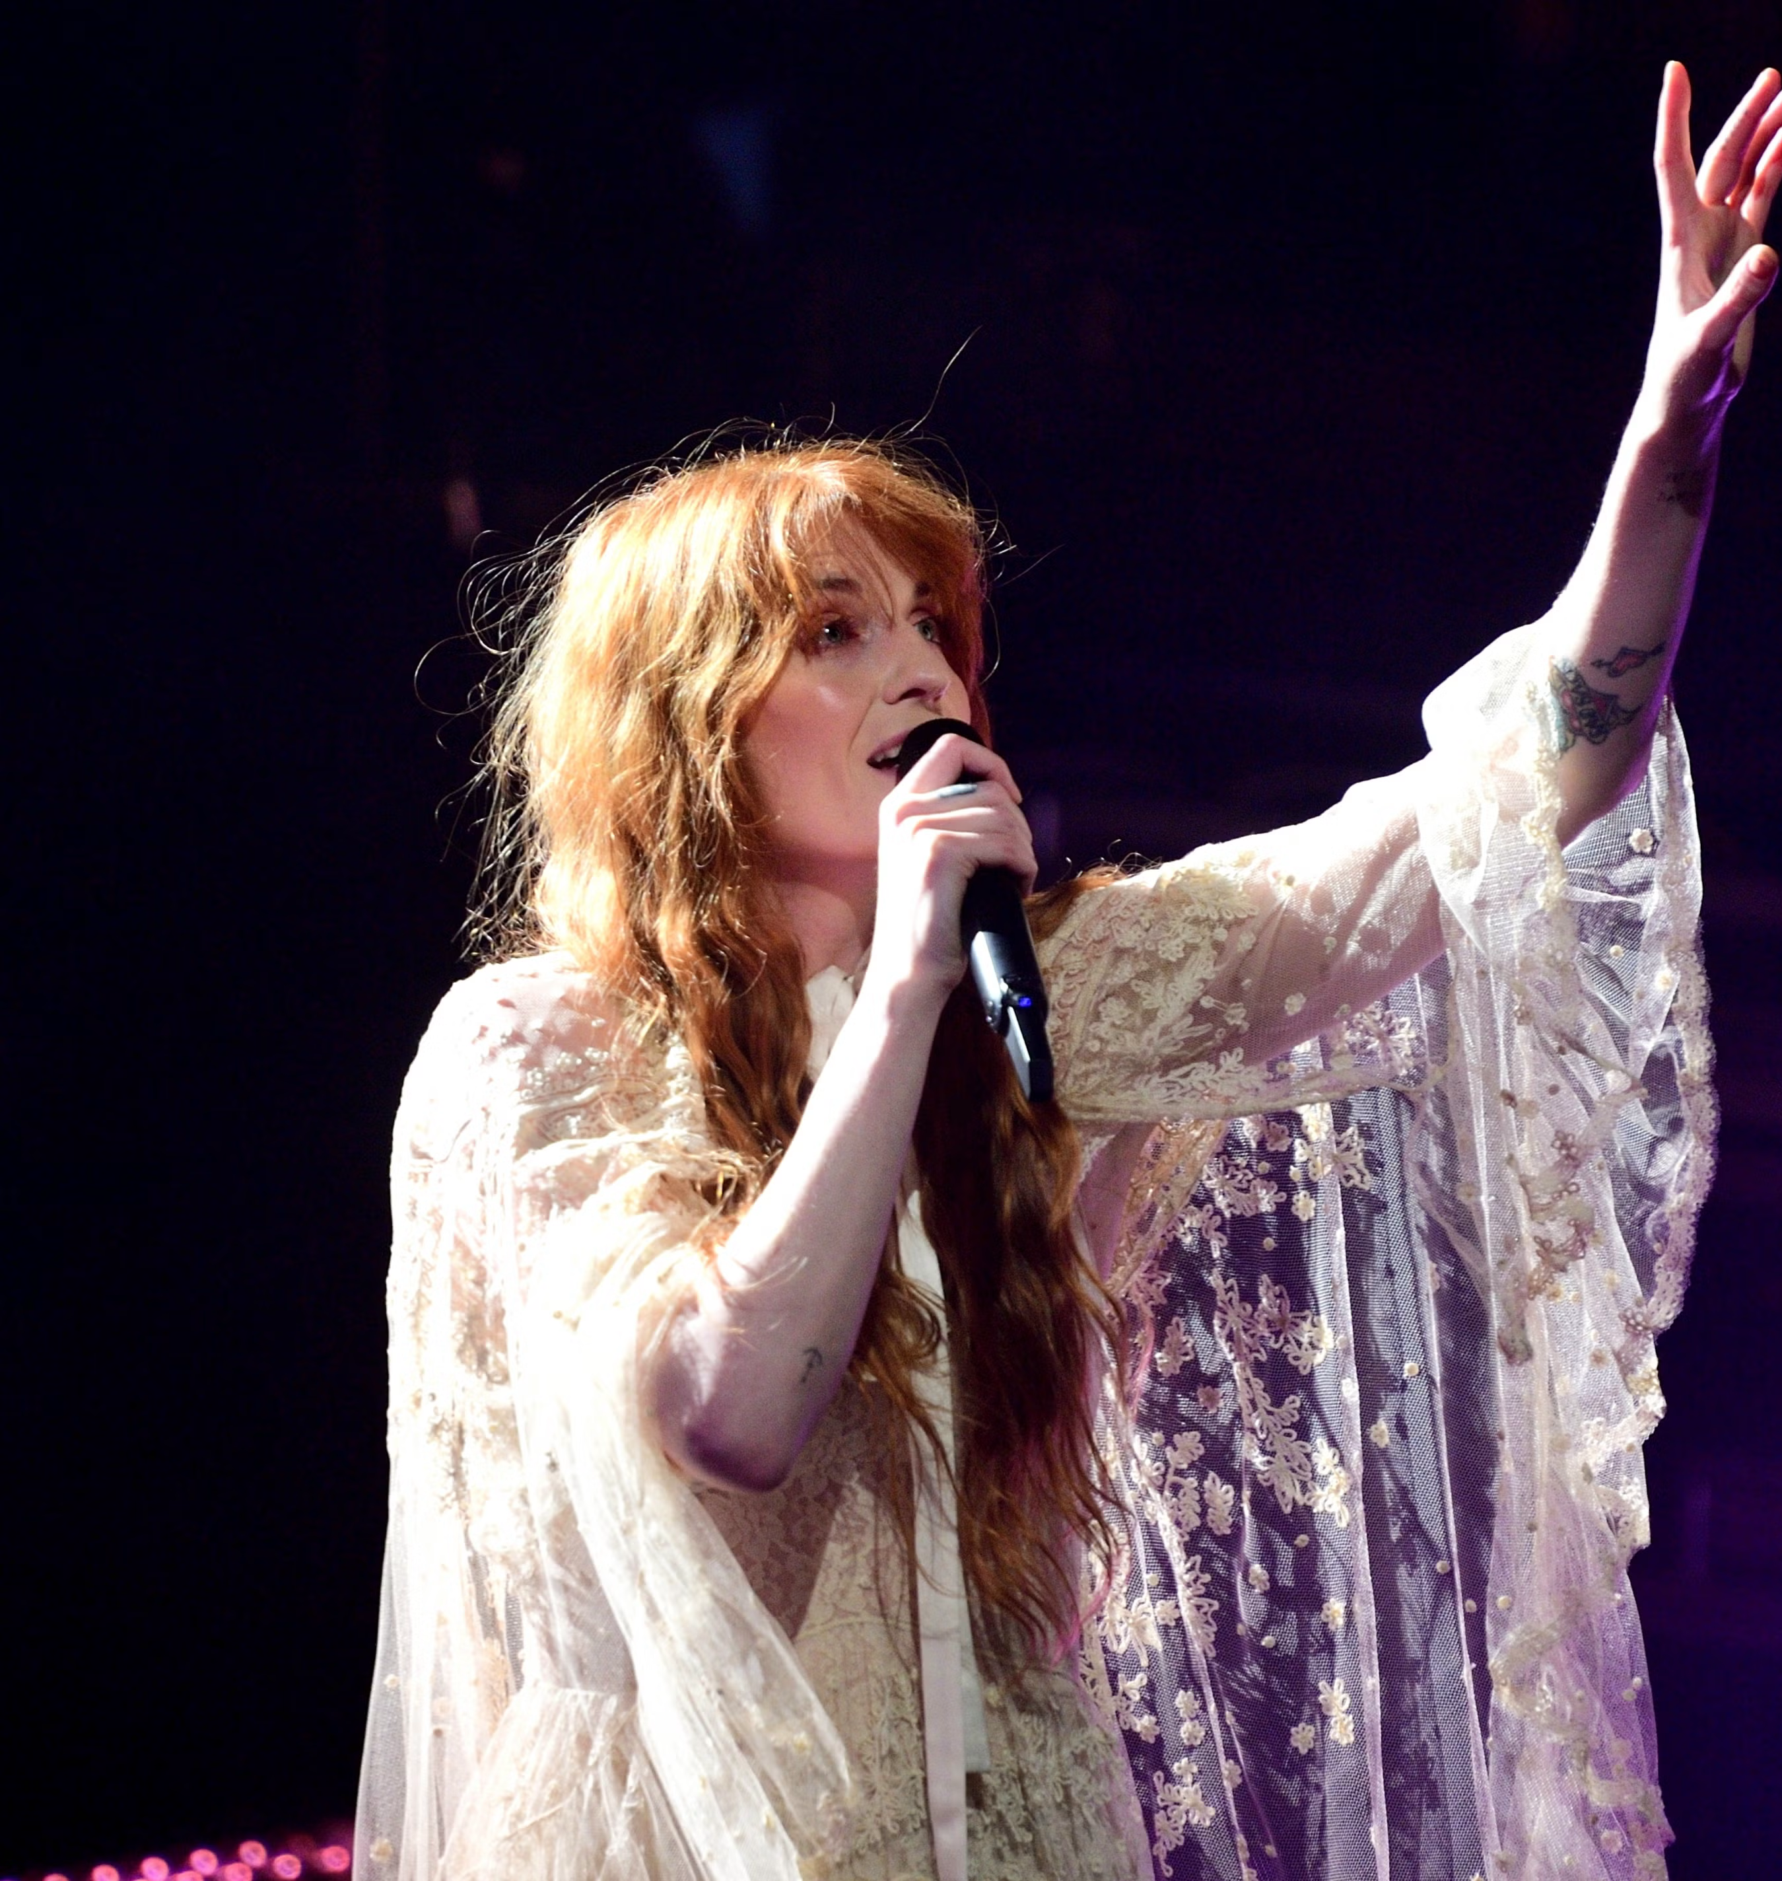
Florence & the Machine
Florence and the Machine is an English band that started in London in 2007. The lead singer is Florence Welch.
The band became famous after being featured on BBC Music Introducing. They also won the "Critics' Choice" award at the Brit Awards in 2009.
Their first album, Lungs, was released in 2009. It became very popular and reached number one on the UK Albums Chart in 2010.
The band's name came from a joke between Florence Welch and her friend Isabella Summers. Florence called herself "Florence Robot" and Isabella was known as "Isa Machine."

Slide 6
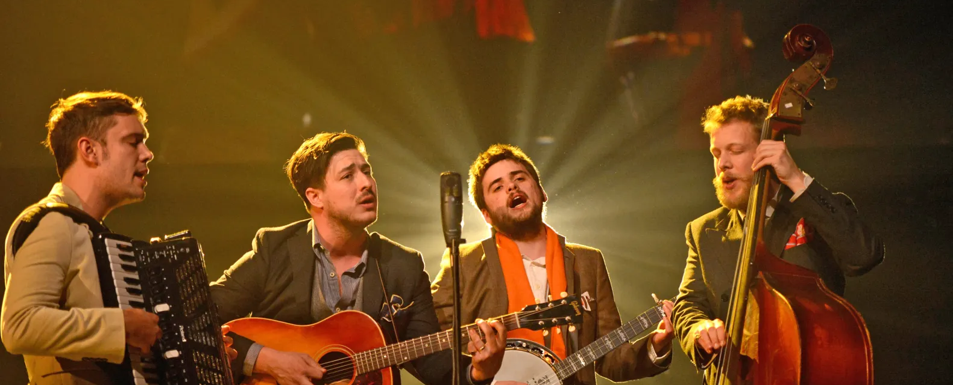
Mumford & Sons
Mumford & Sons is an English folk rock band that started in London in 2007. The band's main members are Marcus Mumford, Ted Dwane, and Ben Lovett.
The band's name comes from Marcus Mumford. Another band member, Ben Lovett, said they chose the name because it sounded like an old family business.
Their first album, Sigh No More, was released in 2009 and became very popular in both the UK and the United States.
Mumford & Sons have won many awards. Their album Babel won the Grammy Award for Album of the Year, and they won the Brit Award for Best British Group in 2013.

Slide 7
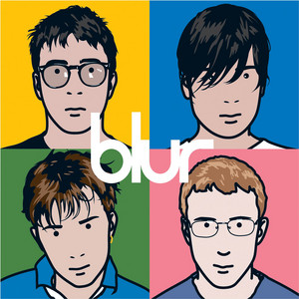
blur
Blur is an English rock band that started in London in 1988. Before they were called Blur, the band was known as Seymour.
The band's members are Damon Albarn, Graham Coxon, Alex James, and Dave Rowntree. They sing and play instruments including guitar, bass guitar, and drums.
Blur helped make Britpop music very popular in the 1990s. Britpop is a style of music with catchy guitar tunes and songs about British life and culture.
One of Blur's most famous albums is Parklife (1994). It was part of a series of successful albums that made the band famous across the UK.

Slide 8
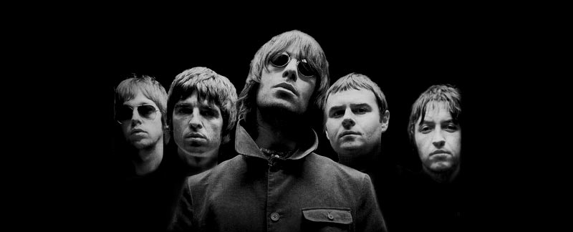
Oasis
Oasis is a famous English rock band from Manchester. The band started in 1991 and became one of the most successful bands of the Britpop music era.
The band's most famous members are brothers Liam Gallagher and Noel Gallagher. Liam is the lead singer, while Noel joined shortly after the band formed and became its main songwriter.
Their first album, Definitely Maybe (1994), was a huge success. It became the fastest-selling debut album in British history at the time.
Oasis recorded famous songs such as "Wonderwall" and "Don't Look Back in Anger". Their album(What's the Story) Morning Glory? became one of the best-selling albums in the world.

Slide 9
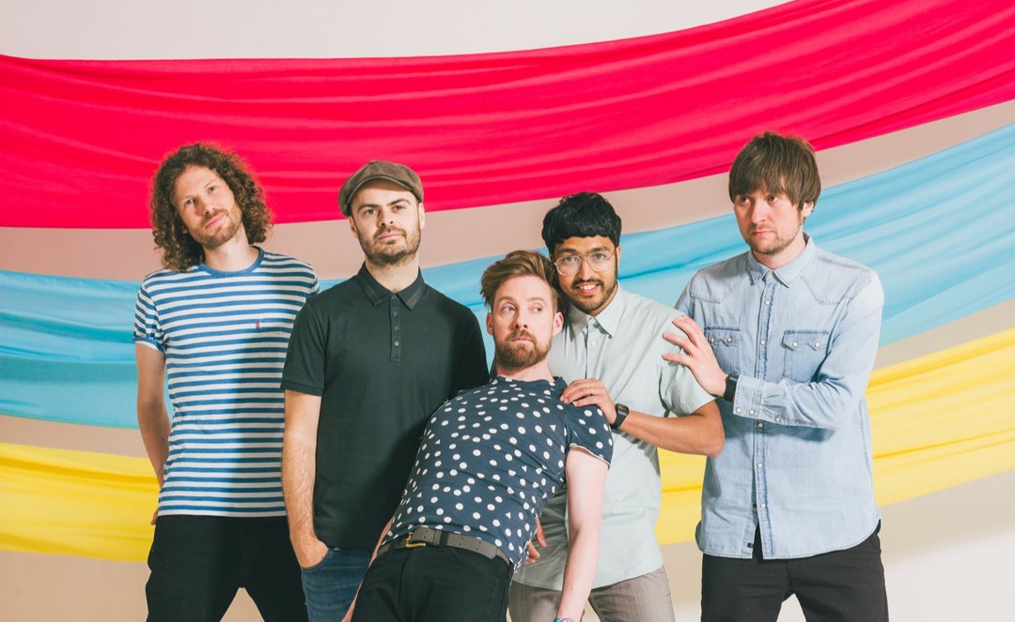
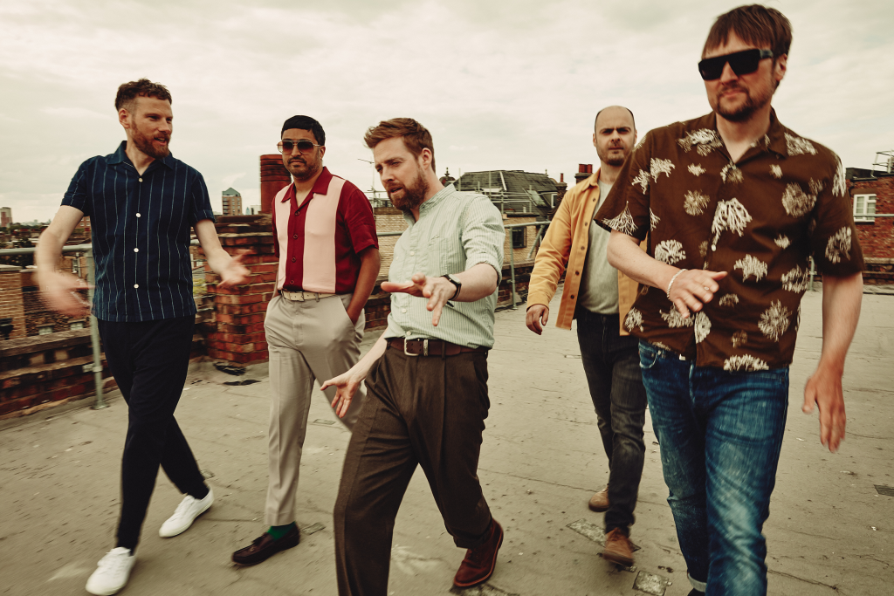
Kaiser Chiefs
Kaiser Chiefs are a rock band from Leeds, England. They are known for their energetic music and catchy songs.
The band started in 2000, but they were originally called Parva. They changed their name to Kaiser Chiefs in 2003.
Their name comes from the Kaizer Chiefs football club in South Africa as one of their favourite football players for Leeds (Lucas Radebe) came from this team.
Kaiser Chiefs have released many popular albums, including Employment (2005) and Yours Truly, Angry Mob (2007). They have been making music for more than 20 year

Slide 10
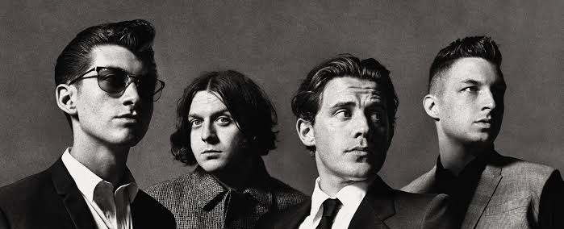
Arctic Monkeys
Arctic Monkeys are a rock band from Sheffield, England. They started making music in 2002 and their members include Alex Turner, Matt Helders, Jamie Cook, and Nick O'Malley.
The band became famous very quickly because people shared their music online. Many people believe they changed the way new bands become popular.
Their first album, Whatever People Say I Am, That's What I'm Not (2006), was a huge success. It sold more copies in its first week than any other debut album in British history at the time and won Best British Album at the 2007 BRIT Awards.
Arctic Monkeys have performed at some of the world's biggest events. In 2012, they performed at the London Olympic Games Opening Ceremony, and they have also headlined major festivals such as Glastonbury

