Slide 1
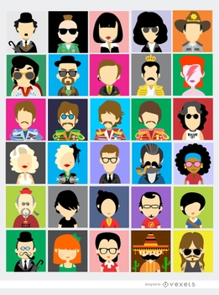
Icons
Artist / Band | Week Beginning
Bowie | 03.11.25.
Elton John | 10.11.25.
Aretha Franklin | 17.11.25.
The Police | 24.11.25.
U2 | 01.12.25.
Michael Jackson | 08.12.25.
Christmas Carol Focus | 15.12.25.
Term 1.2.

Slide 2
David Bowie
Bowie created more than 25 albums, selling about 200 million copies over more than 50 years.
He created music unconstrained by genre and played instruments including keyboard, harmonica, mandolin, koto and stylophone.
He appeared in multiple films and TV shows and supported a variety of charities.
In 1969, ‘Space Oddity’ entered the UK charts and was Bowie’s first big hit.
In 1972, Bowie performed ‘Starman’ dressed as a character he called Ziggy Stardust and reached a new level of fame.
He caused a fashion sensation and redefined what a musical performance could be.

Slide 3
Elton John
Elton John has sold over 300 million records worldwide.
He was knighted by Queen Elizabeth II in 1998 for his services
to music and charity.
He has written soundtracks for films and musicals and was inducted into the Rock and Roll Hall of Fame in 1994.
In 2024, Elton John became the 19th person to have won the prestigious awards of an Emmy, Grammy, Oscar and Tony, earning the title ‘EGOT’.
Elton John has two children with David James Furnish who is a Canadian-British filmmaker

Slide 4
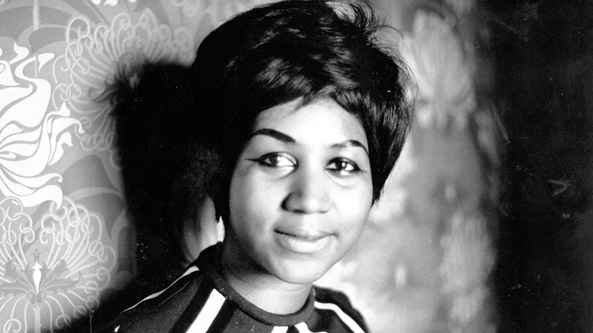
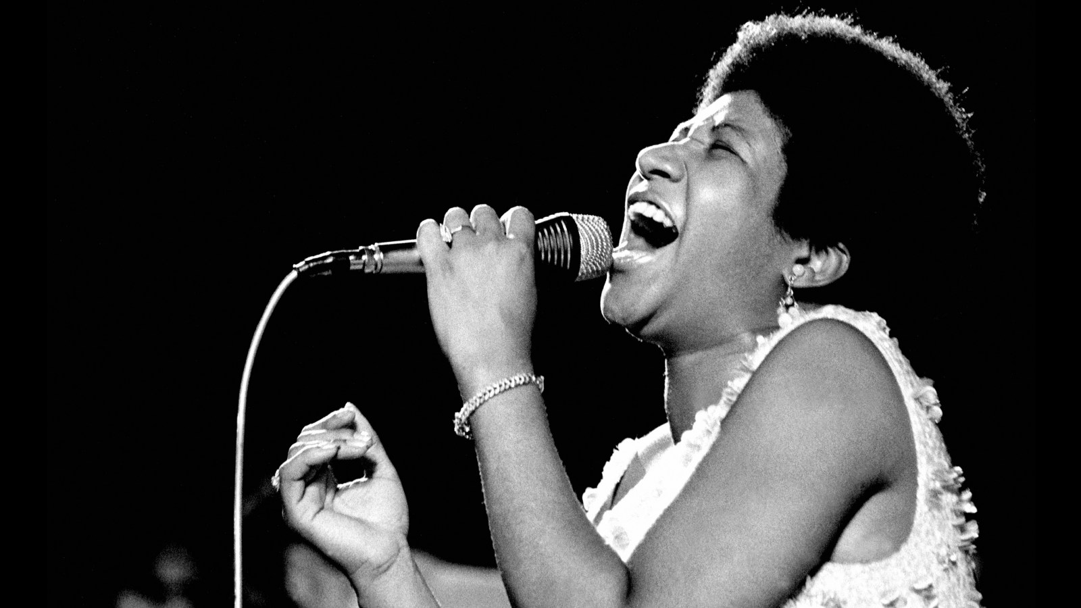
Aretha Franklin
Aretha Franklin was born on March 25, 1942, in Memphis, Tennessee.
Her mother was a gospel singer, and her father was a nationally known minister at the New Bethel Baptist Church in Detroit, Michigan. She sang in the church’s choir and was recognized as a vocal prodigy (an unusually talented child).
In 1987 Franklin was the first woman to be inducted into the Rock and Roll Hall of Fame.
Over the course of her career she won 18 Grammy Awards, including a Grammy Lifetime Achievement Award.
At Barack Obama’s 2009 presidential inauguration Franklin sang “My Country ’Tis of Thee” for a crowd of more than 1 million.

Slide 5
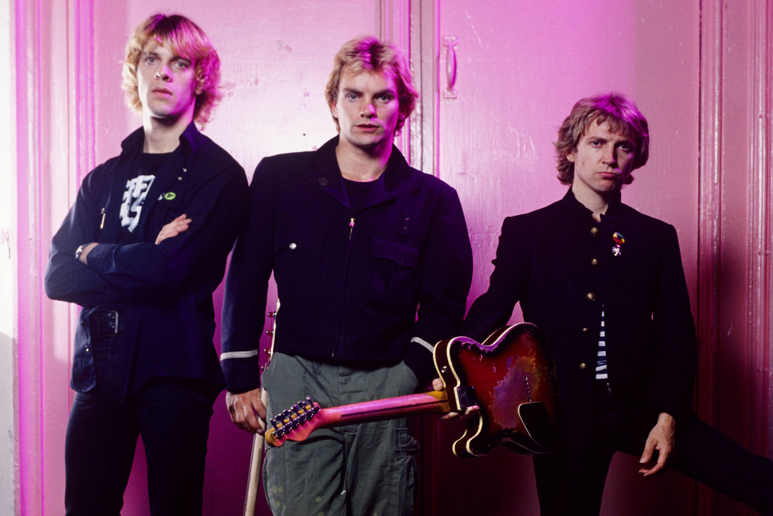
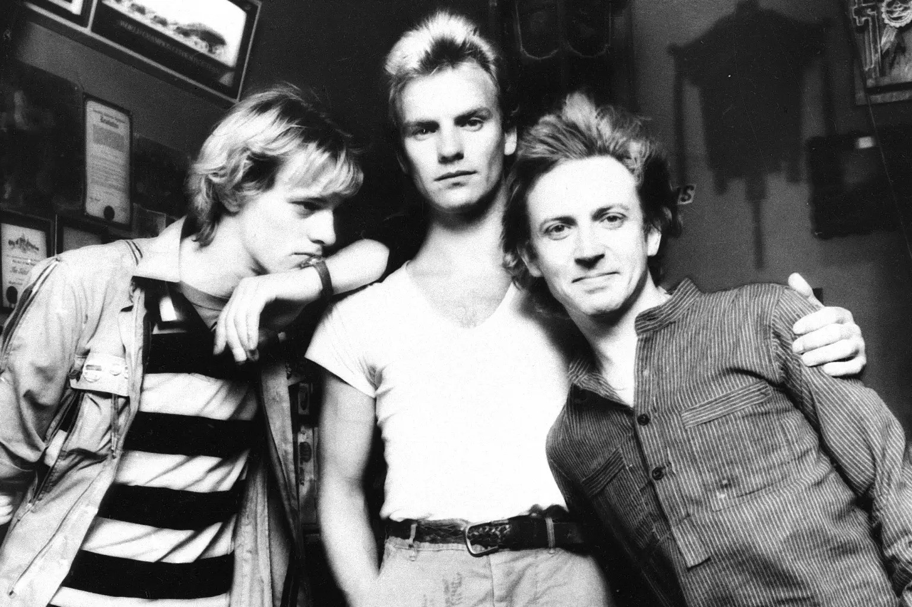
The Police
The Police were a popular British rock band known for blending punk, reggae, and jazz influences.
They formed in 1977, they achieved global success in the late 70s and early 80s with hits like "Roxanne" and "Every Breath You Take".
The band consisted of Sting (vocals, bass), Andy Summers (guitar), and Stewart Copeland (drums).
Some sources say they disbanded in 1986 but reunited for a world tour in 2007-2008.

Slide 6
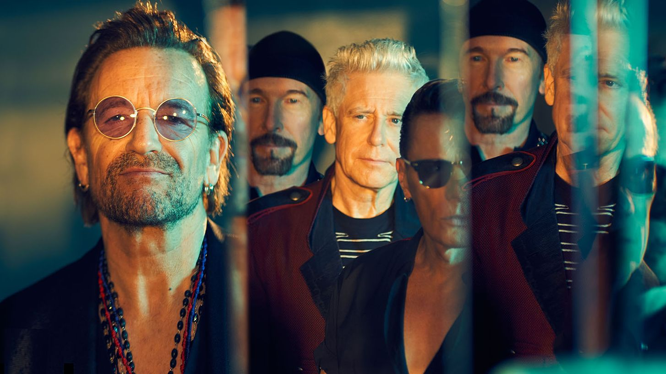
U2
The four members are the lead singer Bono, lead guitarist The Edge, bassist Adam Clayton, and drummer Larry Mullen Junior.
U2 has been very popular around the world since the 1980s.
They have sold over 170 million albums.
They have also won 22 Grammy Awards, which is more than any other rock band

Slide 7
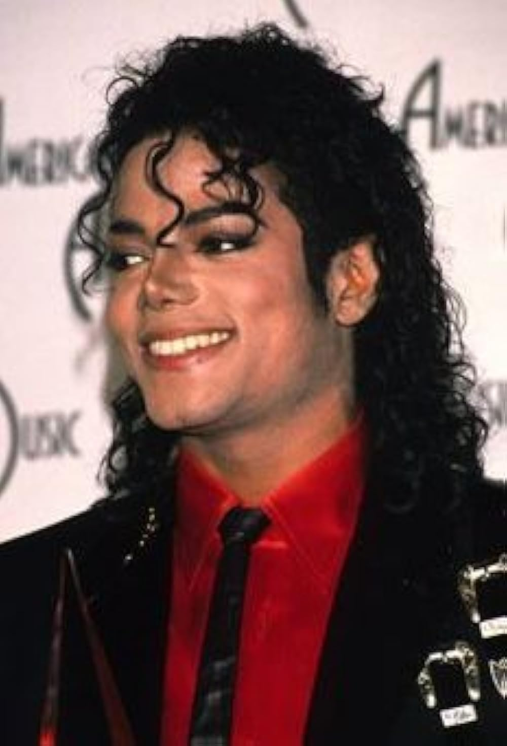
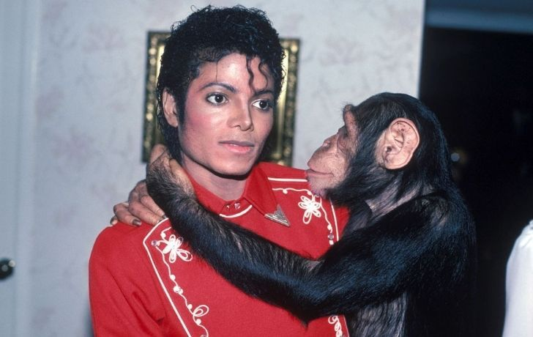
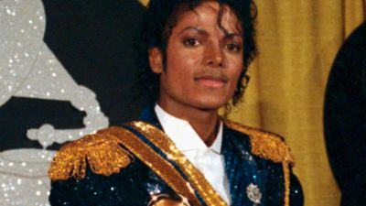
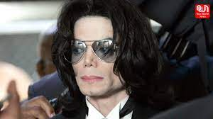
Michael Jackson
Michael Jackson, known as the "King of Pop", was a famous American singer, songwriter, and dancer.
He started his career with the Jackson 5 at a young age and later became a global superstar with hit albums like Thriller.
He was known for his unique music, dance moves like the moonwalk, and iconic fashion.
Michael Jackson was awarded with 23 Guinness World Records, 13 Grammys, and 26 American Music Awards, all of which made him The Most Awarded Artist.

