Slide 1

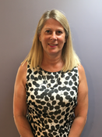

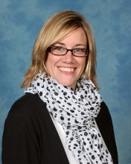
The Designated Safeguarding Lead is
Mrs Wattam
Headteacher
head@boshamprimary.co.uk
The Deputy Designated Safeguarding Leads are
Mr Richmond
Deputy Headteacher
deputy@boshamprimary.co.uk
Mrs Earnshaw
KS2 Leader
mearnshaw@boshamprimary.co.uk

